Slide 1
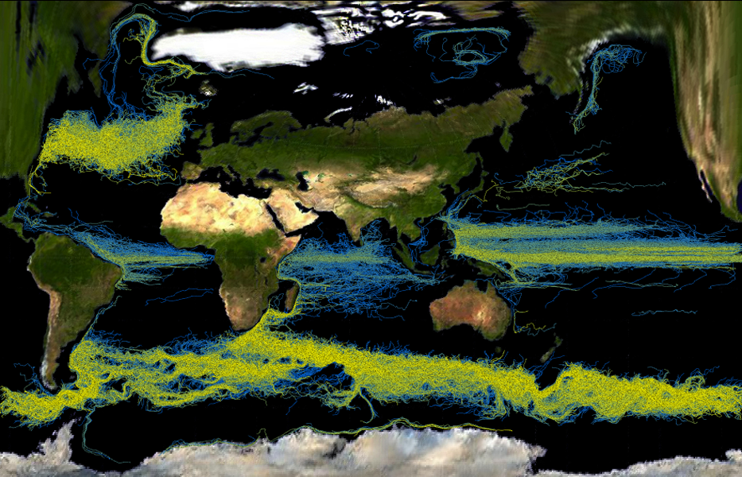
Complex Feature Visualization by Programming Language Interface
Problem
Today multi-scale/physics systems are modeled with unprecedented complexity
A daunting task to manually explore all aspects of such complex systems
Infeasible to always require users to fully substantiate a feature specification in all aspects
In result, traditional visualizations could be unreliable, inconclusive or incomprehensive
Solution
Enabling versatile exploration and visualization of complex features by using supercomputers to automatically explore a feature specification’s un-specified aspects.
Domain scientists control this automation via light weight programming languages (regex).
Impact
Reliably capture and visualize ocean structures at fine precision on global scales
Useful to all climate modelers needing to understand or improve ocean models
statement:
| statement range
| statement multirange
| statement TIMEMARKER range
| statement TIMEMARKER multirange
;
range: RBEGIN values REND
| RWILDCARD
;
values: VALUE RTO VALUE
| VALUE
| RWILDCARD
;
multirange: range MREXPANDER
;
/* floating point numbers */
\-?[0-9]+
| \-?"."([0-9])+
| \-?([0-9])+"."([0-9])*
| \-?([0-9])+\.?([0-9])*[eE]\-?([0-9])+
return VALUE;
\[ return RBEGIN;
\] return REND;
\? return RWILDCARD;
\* return MREXPANDER;
\- return RTO;
T return TIMEMARKER;
[ \t\n] ;
. ;
Notes:
Ocean is a principal component of the Earth’s surface and also a dominant factor in the hydrosphere. When needing to better understand globe climate, it is a crucial step to better understand ocean, especially the laws governing long-term regional and larger scale flows and short-term transient eddies. These features are typically unsteady over time, appearing at varying depths and affected by many factors of chemical and physical nature. Previously, ocean features could not be definitively specified – making it hard to create scientifically useful visualizations using traditional methods. In addition, it is hard to simultaneously resolve ocean features with great geospatial, depth and temporal details, while also capturing the entire global scale of our planet. Through SciDAC Ultravis research, we use leadership computing facilties to automate exploring aspects of numerical, spatial and temporal uncertainties, and hence to capture real-world ocean features that do not perfectly fit with theoretical concepts.
The sample visualizations show results from a recent DOE Earth System simulation that modeled global ocean at 0.1 degree resolution from 2001 to 2003. We are able to visually summarize strong short-term transient ocean eddies (upper image) as well as long term regional scale ocean flows (lower image). Colors represent depth of flow features (warm colors for shallow depths, cool colors for deep depths).
More talking points about the ocean flow features:
Upper image -- Eddies can range from centimeters to hundreds of kilometers in diameter and can persist for periods of days to months.
The result shows significant eddy activity in the Atlantic and the Indian Ocean. Well known eddies such as those nearing Cape of Good Hope are distinctly visualized. As expected, most eddy activities occur near coasts and away from those major currents
Lower image -- The Equatorial and Antarctic currents are clearly shown and the Labrador current near Greenland is also well represented. The Beaufort Gyre, a wind-driven current located in the Arctic Ocean, is also highlighted in this visualization. Another interesting flow is
shown when the major ocean current comes above Australia. The flow lines abruptly disappear when reaching this area because a shift
occurs when the current sweeps between Australia and Indonesia.
Contributors:
SciDAC Ultravis computer scientists:
Wesley Kendall, Jian Huang – University of Tennessee, Knoxville
Han-Wei Shen – The Ohio State University
Tom Peterka, Robert Ross – Argonne National Laboratory
SciDAC Climate scientists:
Robert Jacobs – Argonne National Laboratory

